Slide 1
Marketing Information System
Unit 3

Slide 2

Concept of MIS
Marketing information consists of people equipment and procedure to gather, sort, analyze, evaluate and distribute needed, timely and accurate information to marketing decision makers.
A marketing information system is a set of procedures to collect, analyze and distribute accurate, prompt and appropriate information to different levels of marketing decision makers.
A marketing information system is a set of procedures to collect, analyze and distribute accurate, prompt and appropriate information to different levels of marketing decision makers

Slide 3

Definitions
"A Marketing Information System (MIS) is a system in which marketing data is formally gathered, stored, analyzed, and distributed to managers in accordance with their informational needs on a regular basis.(American Marketing Association)
“A marketing information system consists of people, equipment, and procedures to gather, sort, analyze, evaluate, and distribute needed, timely, and accurate information to marketing decision makers.” (Philip Kotler)

Slide 4
A Marketing Information System (MIS) is a structured system that gathers, analyzes, stores, and distributes marketing data to managers and decision-makers within an organization. The purpose of an MIS is to improve the decision-making process in marketing by providing timely and accurate information. This system combines internal company data, market intelligence, market research, and decision support systems to create a comprehensive resource for marketing strategies and operations.
It is through MIS that the companies of today’s world can compute marketing data and draw meaningful conclusions. MIS helps in business as the collection, analysis, dissemination and reporting of data has become easy and with upcoming software advancements, large amount of data gets analyzed easily.

Slide 5
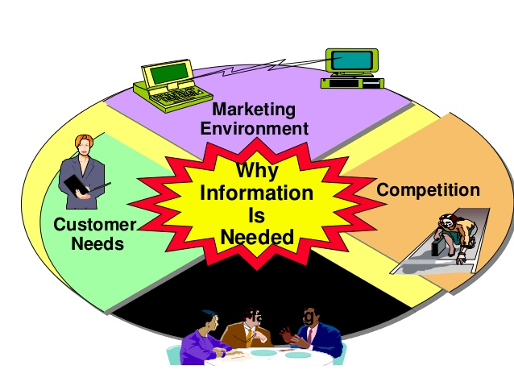
Why it is important?
Advancements in the field of IS and IT have enabled the marketing department to process raw data and to take up fruitful strategic decisions regarding marketing mix and other components of marketing. MIS is a tool used for marketing information management. Marketing Information system (MIS) is the software and hardware system which analyses and accesses the market information which is obtained through primary or secondary research and kept in the database. Nowadays many companies use MIS to support them in taking complicated and decisions related to product launch, product retract, product development or modification, pricing, packaging changes, distribution channels and network, promotional activities, etc.

Slide 6
Anticipation of customer demand: Every marketer needs up to date knowledge about the consumer needs and wants.
Systematic approach: Expanding market and competitive marketing environment require adequate market intelligence system.
Economic indicator: Marketers must have latest information on the changing trends of supply, demand and prices.
Understanding the consumer: Information system can establish proper two-way flow of information and understanding between marketers and consumer.
Marketing planning: Marketing plans and programme are based upon information supplied by economic forecasts and market research.
Significance of analyzing competition: Marketer cannot survive without having information regarding nature, character and size of competition to be met.
Development of technology: Marketers must have latest information regarding technological development.

Slide 7
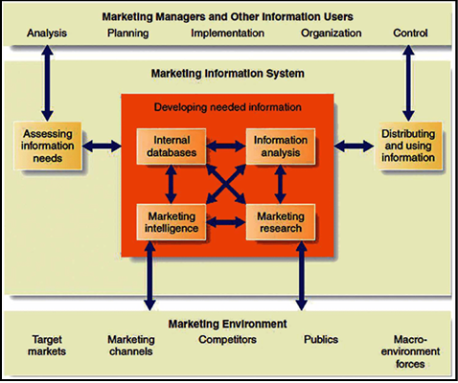
Overview of Component of MIS
A marketing management system is needed to understand the marketing environment as well. The changes in the industry, cultural shifts, as well as internal records of transactions through marketing efforts, etc., are included in this system.

Slide 8
Central Block - Marketing Information System:
The central block represents the core of the MIS, which is responsible for developing needed information through various processes.
Developing Needed Information:
Internal Databases: These are databases within the organization that store sales records, customer data, financial information, and other internal data.
Marketing Intelligence: This involves collecting data from external sources such as market reports, competitor analysis, and industry trends.
Marketing Research: This refers to specific research projects designed to address marketing questions or issues through methods like surveys, focus groups, and experiments.
Information Analysis: This process involves analyzing the collected data to generate meaningful insights and actionable information.

Slide 9
Assessing Information Needs:
This part involves determining what information is required by the organization to make informed marketing decisions. It is an ongoing process that ensures the MIS is aligned with the organization’s strategic goals and market dynamics.
Distributing and Using Information:
Once the information is developed and analyzed, it is distributed to the relevant users within the organization, such as marketing managers and other decision-makers, to be used in planning, implementation, organization, and control of marketing activities

Slide 10
This figure illustrates how an MIS integrates internal and external data to provide valuable insights that support marketing decision-making. It highlights the continuous loop of assessing information needs, gathering and analyzing data, and distributing this information to be used in various marketing functions. The MIS interacts dynamically with the marketing environment, ensuring that the organization remains informed and agile in a constantly changing market landscape.

Slide 11

Internal Records System
The first component of MIS is ‘Internal Record’. It is backbone of any marketing information system. Marketing managers get lots of information from the internal-records of the company. These records provide current information about sales, costs, inventories, cash flows and account receivable and payable. Many companies maintain their computerized internal records. Inside records help marketing managers to gain faster access to reliable information. Some of the key information that can be part of internal records are- customer profiles, pricing strategy, inventory, list of employees, market segmentation information, debit and credits, past data and reports etc.

Slide 12
For instance: When orders are made online, businesses choose eCommerce sites that provide an order management system. This system instantly notifies the sales team that the order is placed. Then comes the aspect of inventory management where the item is prepared for dispatch and if the product is out of stock, the inventory management system immediately notifies the sales team in real-time. The package is prepared for dispatch, a customer invoice is generated, and payment is automatically collected. There should be no challenges in this cycle, otherwise, the customer will not be satisfied. For that, you can take the help of customer satisfaction surveys. The key is to be quick and accurate, and this should be made known to the marketing manager. They also need immediate feedback from customers after the order is placed or received. Apart from that, data of profit and loss reports, cost of personnel in the marketing team, etc., are to be made available to the marketing manager.
All such information helps the Marketing Information System to make decisions regarding the future of marketing. When you leverage a MIS, you can gain unparalleled insight into your division’s performance and marketing capabilities.

Slide 13
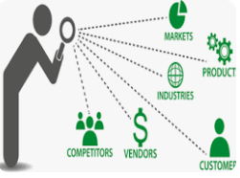
Market Intelligence
When used effectively, Marketing Intelligence can help you keep track of what’s going on in the marketing environment. It involves collecting and analyzing all the data related to the marketing environment, such as competitor activities, customer behavior, and emerging trends. Gaining Marketing Intelligence allows you to anticipate what your customers may want or need in the future. By keeping an eye on certain external factors, you can come up with product innovation that can help keep your business ahead of the competition. Marketing intelligence also helps you to better understand the underlying dynamics of your target markets. This can be especially useful when it comes to making decisions about where and how to advertise, which products to focus on, and other key strategies.

Slide 14
Kotler suggests various ways to gather such intelligence. Some are mentioned below.
Sales team can keep an eye on new developments of customers’ choices
Distributors and vendors (the external microenvironment) can be asked to provide insights on various aspects that they deal with in their respective domains.
Companies can purchase the competitors’ products to know their pricing strategy.
One of the best modern-day methods to extract what is happening in the market is social media. There you can gauge the potential of your market growth, find trends promoted by influencers, etc. A marketing intelligence system also looks broadly into consumer behavior so that marketing managers can know the consumer’s preferences, demographics, etc.

Slide 15

Marketing Research System
A marketing research system is an important part of a Marketing Information System. It involves gathering data from external sources for decision-making. This includes everything from primary and secondary research to surveys, focus groups, interviews, and more.
Having access to such information can help you gain insights into the current marketing, customer needs and preferences, competitive analysis, and much more. Marketing research is a powerful tool that can give you the edge you need to succeed in your industry.

Slide 16
“Marketing research is a systematic design, collection, analysis and reporting of data and finding relevant to specific marketing situation facing the company”, Philip Kotler.
A marketing research system is a structured approach for collecting, analyzing, and interpreting data relevant to marketing decision-making. It involves various methodologies and tools to understand market trends, consumer behavior, competitive landscape, and other critical factors affecting a business.
The main purpose of marketing research is to provide reliable and sufficient information needed for taking marketing related decisions. In marketing research, at first problems should be defined. Then gradually, objective of the research should be prepared, research plan be developed, necessary information be collected and analyzed, and conclusion be drawn. The major sectors of marketing research are as follows:

Slide 17
Product Research: Product research is one of the important areas of marketing research. While researching a product, a detailed study and analysis is done on development of new product, product life cycle, brand loyalty, product positioning, product experiment, packaging, design etc.
Price Research: Price research is also another important research area of marketing research. While researching price, detailed study and analysis is done on the method of pricing, trend of pricing, cost structure, price of competitors’ products and their pricing policy.
Sales Research: The other important area of marketing research is sales research. While researching sales, a detail study and analysis is done on sales turn-over, market share, sale performance, future market, sale forecasting etc.
Competition Research: Research should also be done on competitors while carrying out marketing research. Degree of competition and their strategy should be studied in detail and analyzed.

Slide 18

Decision Support System
An MDSS is a computerized system that helps you make marketing decisions. It is powered by Marketing Information Systems and leverages the data collected from internal and external sources.
It provides an integrated approach to decision-making and can be used in both strategic planning and tactical execution. A Marketing decision support system allows you to process, organize and analyze the data to make informed marketing decisions.

Slide 19
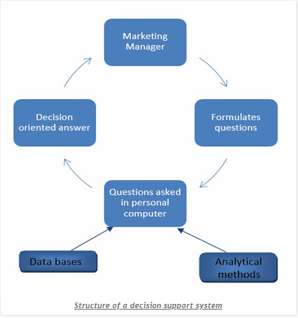
An MDSS can help you identify new opportunities, develop insights into customer behavior, optimize the use of resources, and study the effectiveness of campaigns. It enables you to quickly react to market changes and take advantage of them before it’s too late. A marketing data support system is also a great tool for testing new marketing strategies and measuring the impact of your efforts.

Slide 20
The components of marketing decision support system are as follows:
Data bank: A business firm collects different information from different sources. The store where such information is kept is called data bank. Every necessary kind of information can be found in such data bank.
Method bank: Different kinds of statistical tools are needed to analyze collected information. For example: average percent, classification, tabulation, regression, co-relation, survey, diagram, cluster analysis, factor analysis etc. The store to keep such different methods is called method bank.
Model bank: Decisions need to be taken on different heads in marketing. Decision should be rational and effective. Different kinds of quantitative models should be used to bring simplicity and effectiveness in decision-making process. These models define interrelationship among different elements. These models include sale response, model, new product pretest model etc.

Slide 21

Thank you

